Slide 1
PERCEPTION

Slide 2
Today’s class
Comparison of Marks
Dynamics of Perception
Elements of Perception
Consumer Imagery
Positioning of products
Perceived risk

Slide 3

Whether the centre circle are same in size?

Slide 4

Whether the lengthy lines are parallel.
Zollner Illusion

Slide 5
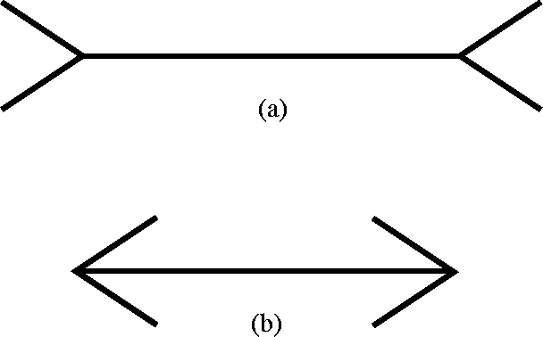
Tell me, which one is lengthy?
Muller Iyer Illusion

Slide 6
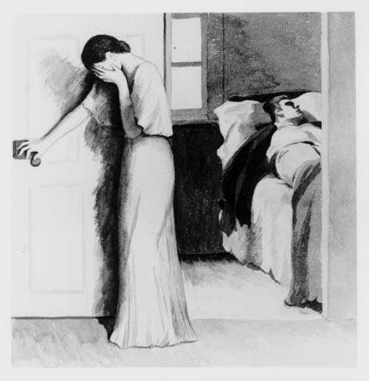
Write a story.

Slide 7
PERCEPTION
The process by which an individual selects, organizes, and interprets stimuli into a meaningful and coherent picture of the world.

Slide 8
Dynamics of Perception
Sensation – immediate and direct response of the sensory organs to stimuli.
Stimulus – any unit of input to any of the senses.
Sensory receptors – Eyes, Ears, Nose, Mouth and Skin
THE ABSOLUTE THRESHOLD:-
◉ The lowest level at which an individual can experience a sensation. [ Detecting difference between “something and nothing”]

Slide 9
Sensory Adaptation:-
  Getting used to senses.
The Differential Threshold:-
  Minimal difference detected between two similar stimuli
  Ernest Weber 19th Century.
Marketing Applications:-
  Negative changes are not readily seen (price rise, reduce in quantity)
  Positive changes are clearly seen.

Slide 10
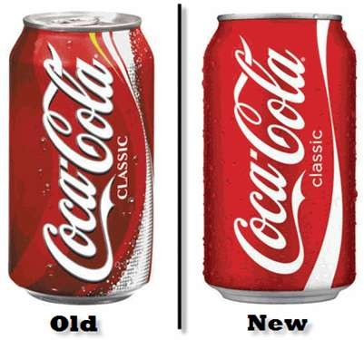
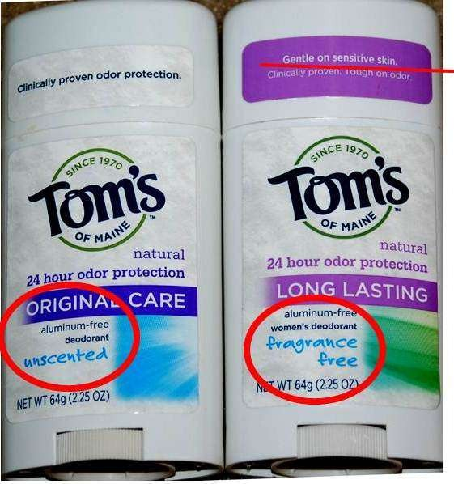

Slide 11
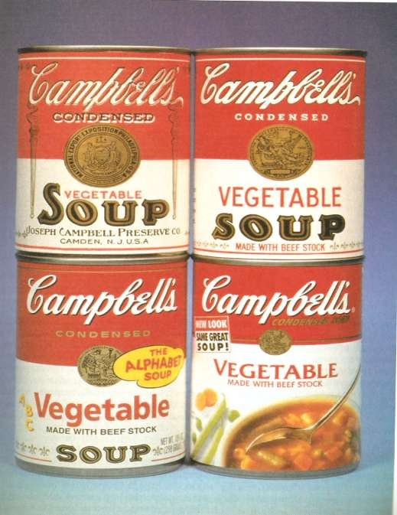

Slide 12
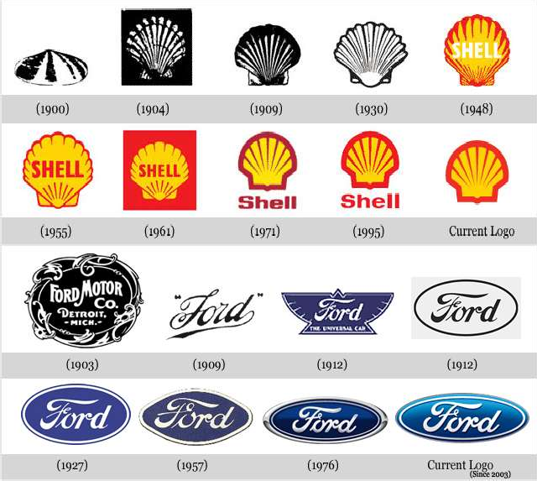

Slide 13
Subliminal Perception
Message below the threshold level – below the conscious level.
  Takes place in movies – Motorola Mobile Phone with Kamalahassan in Vettaiyadu Velaiyadu.
  MRF Tiers in Indian Movie.

Slide 14
Elements of Perception
Perceptual Selection
Perceptual Organization
Perceptual Interpretation

Slide 15
Perceptual Selection
Stimuli get selected on two factors:-
  Consumers previous experience affects their
expectation
  Motives at the time
1) Nature of the stimulus
  Nature of the product, physical attributes, the package design, brand name and advertisements (includes copy, choice and sex of the model, positioning, size of ad)
  CONTRAST – Difference creates more attention towards the ad.

Slide 16
2) Expectations:-
  People see what they want to see, based on previous experience, familiarity and preconditioned set of expectations.
  Marketers believed that high degree of sexuality creates more attention.
3) Motives
  People perceive the things they need and want – Stronger the need – Greater tendency to ignore unrelated things.
  People who are obese see ads related to gyms and diet.

Slide 17
SELECTIVE PERCEPTION
Example: Airtel Super Singer.
Selective exposure:-
  People look for pleasant and sympathetic messages and avoid painful or threatening ones.
Selective attention:-
  People look into ads which will satisfy their need.
Perceptual Defense:-
  People avoid psychologically threatening ones.
Hence constantly change the ad nature. [ Smoking – warning with words, and now with images ]

Slide 18
Perceptual Blocking:-
◉ People block stimuli which is bombarded.

Slide 19
Perceptual Organization
People see everything as a whole.
Gestalt Psychology
  Figure and Ground
  Grouping
  Closure

Slide 20
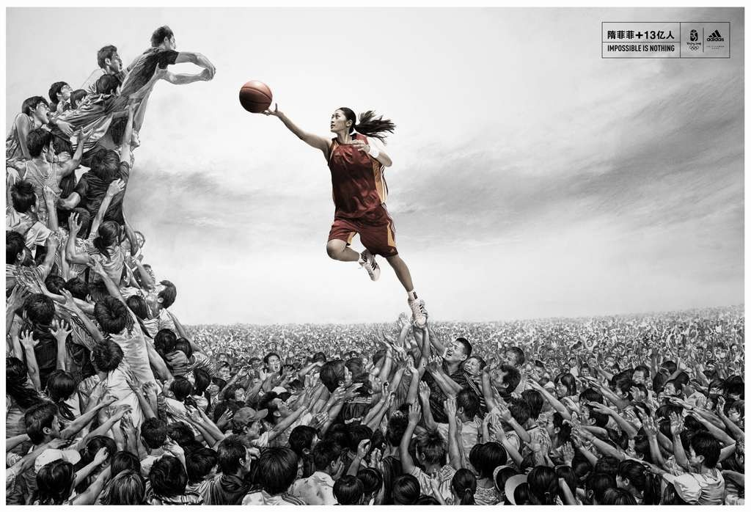
Figure and Ground

Slide 21


Figure and Ground in Product Placement
You will certainly notice Coke kept here

Slide 22

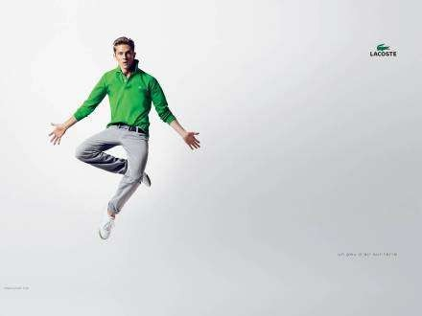
Figure and Ground

Slide 23

Grouping

Slide 24
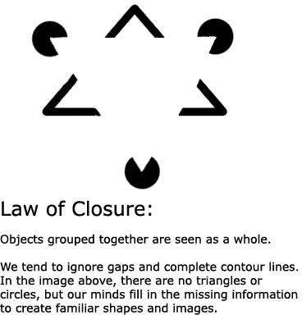

Closure

Slide 25
PERCEPTUAL INTERPRETATION
Stimulus are often highly ambiguous or weak.
  Washing Machine Story.
  Projective techniques
Stereotypes
Physical Appearances
Descriptive terms
First Impression
Halo Effect

Slide 26
Stereotypes
People carrying biased pictures in their minds of the meanings of various stimuli.
People hold meaning related to stimuli
Stereotypes influence how stimuli are perceived
Bias in United Colors of Benetton.

Slide 27

Problematic Ad of UCB

Slide 28
Physical Appearances
People associate quality with people in the ads.
Attractive models have positive influence
Colors of juices.
Shape of the package
Average men are not considered as businessman.
  Ex: Bill gates Vs Sarathbabu Elumalai

Slide 29

Which one is orange juice?

Slide 30
Descriptive Terms
Stereotypes are reflected in Verbal messages.
  Accenture – High Performance, Delivered.
  KFC – Spicy Chicken
  McDonald – Happy price (targeting Indians who are price conscious)

Slide 31




Which one is a courier company?

Slide 32
First Impressions
First impressions are lasting
The perceiver is trying to determine which stimuli are relevant, important, or predictive

Slide 33
Halo Effect
Consumers perceive and evaluate product or service or even product line based on just one dimension.
Important with spokesperson choice.
Tampering the halo effect is detrimental to the organization.
  Toyota – Quality.
  Ford – Safety.
  Sony - Music

Slide 34
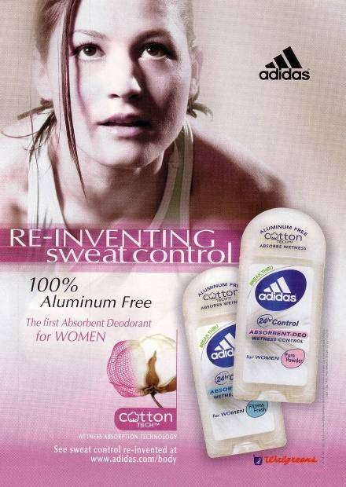
The halo effect helps Adidas break into new
product categories.

Slide 35
Consumer Imagery
Consumers perceived images about product, services, prices, product quality, retail stores and manufacturers.
People buy product to enhance their self image (relating themselves to the product).

Slide 36
POSITIONING
Image of the product in the minds of the customer is called POSITIONING
Image of your product gear up your sales, but the product should also deliver it performance.
Product BENEFITS should be focused more than it’s physical attributes.

Slide 37
Umbrella Positioning
Nicolo Pome, UK marketing director for Nivea’s parent company Beiersdorf, said: “We wanted to find a more relevant role for the Nivea brand in our target markets' minds”. The awareness of the Nivea brand is vast but we needed to find a way to engage with the audience to a greater degree.
An umbrella branding strategy, is
marketing practice that involves selling many related products under a single brand name.

Slide 38
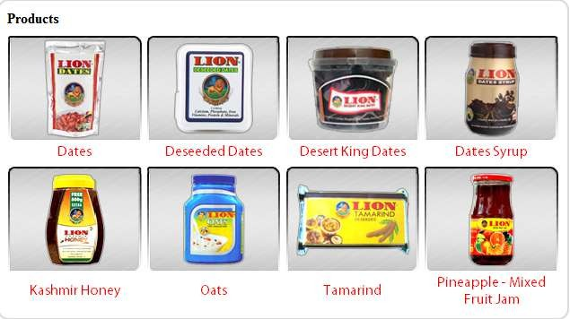
Example: Lion Dates, Amul.

Slide 39
Positioning Products and Services
Model of Strategic Positioning:
Positioning Aim(s)
Positionin g Objectives
Positionin g Strategy (ies)
Communi cations
Consumer Perceptio ns

Slide 40
Typology of Strategic Positioning
Top of the range – Upper class – Rolls Royce
Service – Impressive service – Pizza hut – 30 mins
Value for money – Affordability – Megamart,Europa
Reliability – Durability – Lakshmi grinders- 7yrs warranty

Slide 41
Attractive – Cool, Elegant – Mercedes, Bournville
Country of Origin – Patriotism- Amul- The Taste of India
The Brand Name – Leaders in the market – Apple, Sony
Selectivity – Discriminatory – Nano, Macbook Air

Slide 42
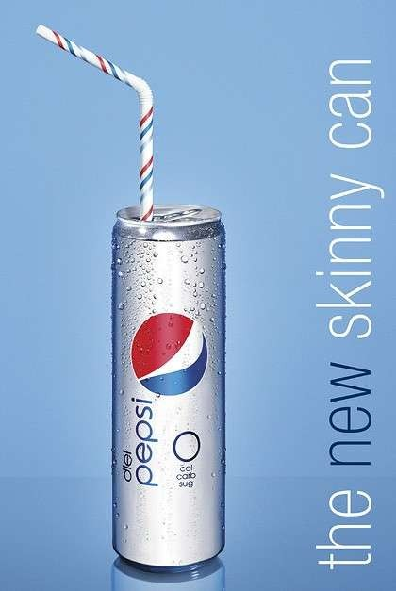
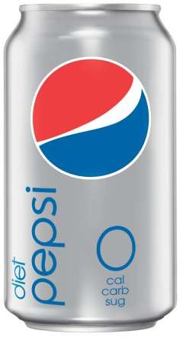


Packaging As Positioning Element
Package must convey the image of the brand.
Wrong
Right

Slide 43
Product Repositioning
Why repositioning is required?

Slide 44
To face the competitors, who offer new products or service.
Changing lifestyle of people, you need to suit the current trend. Eg) Evolution of Xerox and Apple.
When brand need to change their target segment (happens rarely)
Company want to advertise new offerings
To motivate customers to buy a product.

Slide 45
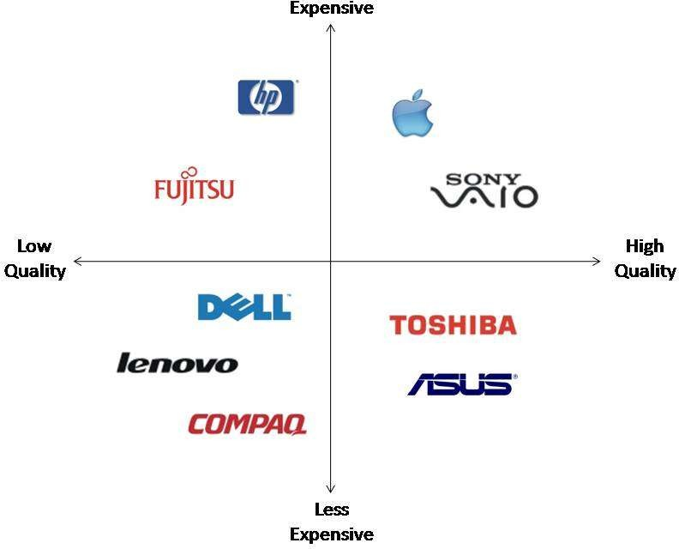
Perceptual Mapping

Slide 46
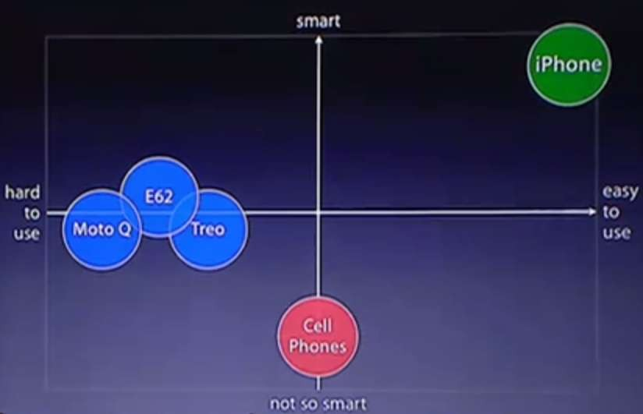
Apple Iphone Perceptual Map

Slide 47
Positioning of Services
It’s difficult to position a service because it’s intangible.
Only Image differentiation helps to position better among their competitors.
Examples:
  Flipkart.com – Reliable
  Pizza Hut – Fast in Delivery

Slide 48
Perceived Price
Perceived price should reflect the value that the customer receives from purchase.
Perceived price reflect on Purchase intentions and Purchase Satisfaction.
REFERENCE PRICE:-
  Internal – From customers memory
  External – From companies and environment.

Slide 49
Perceived Quality
Intrinsic Cues – People actually experience the product here. Physical Attributes of the product.
  Eg) Shape, Size, and Color.
Extrinsic Cues - Absence of actual experience with a product.
  Consumer often “evaluate” quality on the basis of factors quite external to the product itself, such as its price, the image of the store(s) that carries it, or the image (that is, the reputation) of the manufacturer that produces it.

Slide 50
Price/Quality Relationship
Most consumers rely on price as an indicator of product quality.
Consumers use price as a surrogate indicator of quality when they have less information of the product. Eg:-purchase of apparels of a new brand.
When consumers are familiar with the product or have used it before price declines as a determining factor in evaluation.

Slide 51
Perceived Risk
“The uncertainty that consumers faces when they cannot foresee the consequences of their purchase decisions”
Types of Risk
1) Functional 2) Physical 3) Financial 4) Social
5) Psychological 6) Time

Slide 52
Handling Risk
Consumers seeks information
Consumers are brand loyal
Consumers select by brand image
Consumers rely on store image
Consumers buy most expensive model
Consumers seeks reassurance

